Slide 1
Vayeizei, nov 2020

Slide 4
Notes:
Wenceslas haller 1607-1677

Slide 5
Walter Benjamin and Hannah Arendt

Slide 6
Walter Benjamin (1892 Berlin, 1940 Port Bou), 9th Thesis of Philosophy of History
A Klee painting named ‘Angelus Novus’ shows an angel looking as though he is about to move away from something he is fixedly contemplating. His eyes are staring, his mouth is open, his wings are spread. This is how one pictures the angel of history. His face is turned toward the past. Where we perceive a chain of events, he sees one single catastrophe which keeps piling wreckage and hurls it in front of his feet. The angel would like to stay, awaken the dead, and make whole what has been smashed. But a storm is blowing in from Paradise; it has got caught in his wings with such a violence that the angel can no longer close them. The storm irresistibly propels him into the future to which his back is turned, while the pile of debris before him grows skyward. This storm is what we call progress.

Slide 7
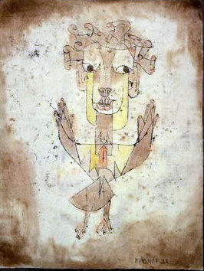
Paul Klee, The Angelus Novus

Slide 8
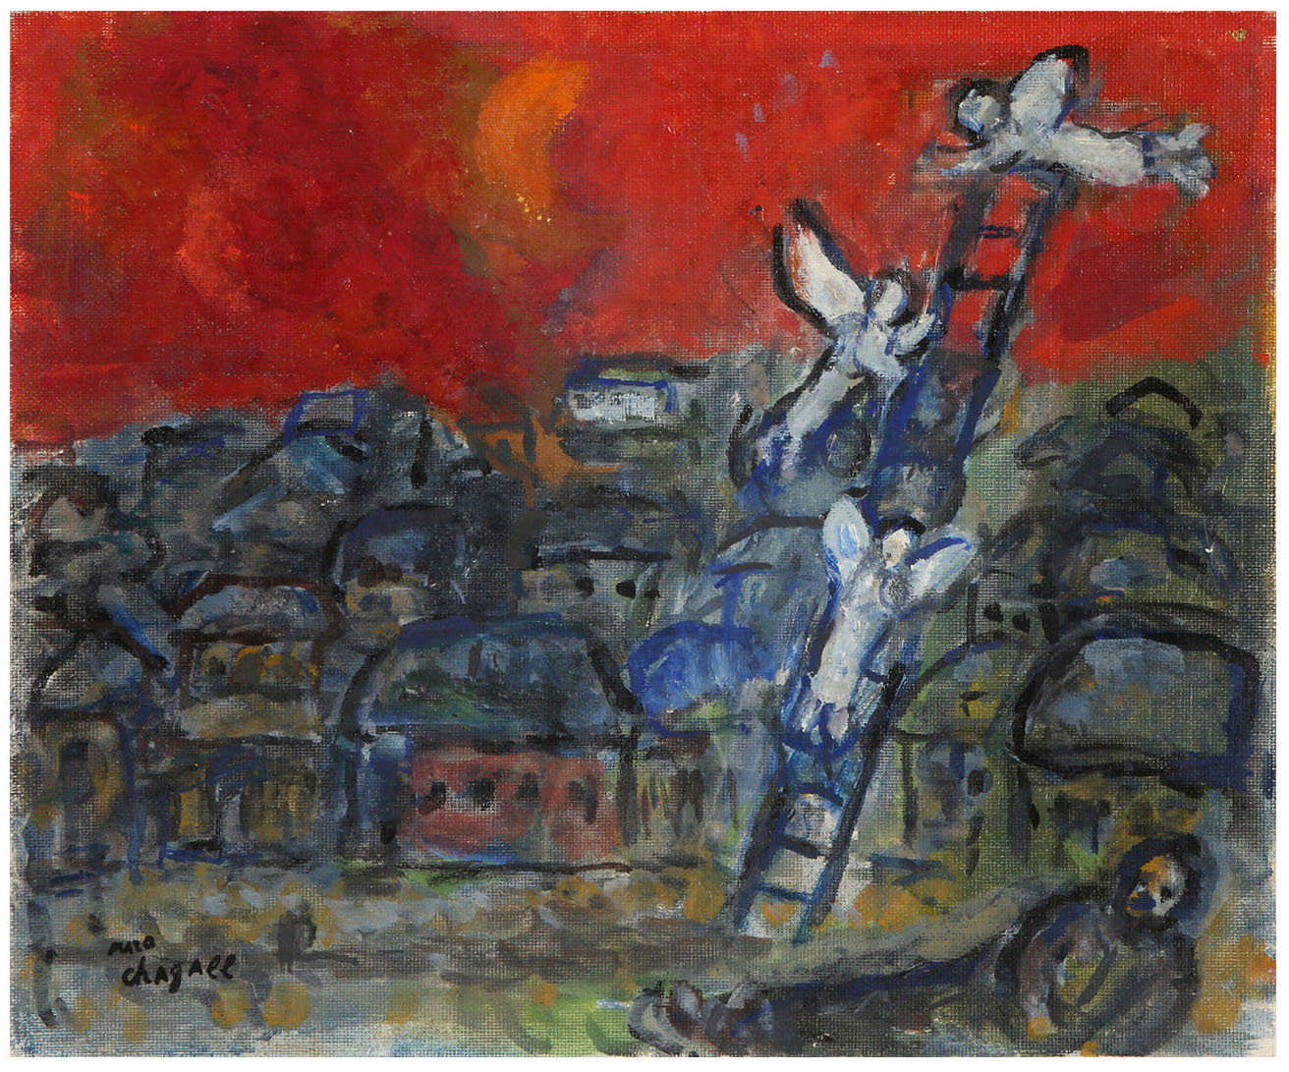
11And he arrived at the place and lodged there because the sun had set, and he took some of the stones of the place and placed [them] at his head, and he lay down in that place.
12And he dreamed, and behold! a ladder set up on the ground and its top reached to heaven; and behold, angels of God were ascending and descending upon it.
13And behold, the Lord was standing over him
Notes:
CHAGALL, 1973. Jacob’s ladder

Slide 9
46And Jacob said to his kinsmen, "Gather stones," and they took stones and made a pile, and they ate there by the pile.
47And Laban called it Yegar Sahadutha, but Jacob called it Gal ed.
48And Laban said, "This pile is a witness between me and you today." Therefore, he called it Gal ed.
49And Mizpah, because he said, "May the Lord look between me and you when we are hidden from each other.
50If you afflict my daughters, or if you take wives in addition to my daughters when no one is with us, behold! God is a witness between me and you."
51And Laban said to Jacob, "Behold this pile and behold this monument, which I have cast between me and you.
52This pile is a witness, and this monument is a witness, that I will not pass this pile [to go] to you and that you shall not pass this pile and this monument to [come to] me to [do] harm.
53May the God of Abraham and the god of Nahor judge between us, the god of their father." And Jacob swore by the Fear of his father Isaac.

Slide 10
Chagall, Israel, 1973
Notes:
Chagall 1973, israel

